Slide 1



Natalie’s Google Capstone Project:BellaBeat
Where maintaining your health just got smarter!
2022

Slide 2
Introduction
Bellabeat is a technology manufacturer of health-focused smart products for women.
Its wellness app along with multiple smart devices collect data on activity, sleep, stress, hydration levels, and reproductive health to empower women with an understanding of their own health and habits.
The company was founded in 2013 by Urška Sršen and Sando Mur.
Since then, Bellabeat has expanded its market strategy and is now working to become a greater player in the global smart device market.

Slide 3
Phase 1: Ask
Business Problem: Analyze existing competitors’ data to identify potential growth opportunities and recommendations for Bella beat’s market strategy.
Stakeholders: Urska Srsen, Sando Mur & BellaBeat’s Marketing Analytics Team.
Questions for the analyses:
What are some trends in smart device usage?
How could these trends apply to Bellabeat customers?
How could these trends help influence Bellabeat marketing strategy?

Slide 4
Phase 2: Prepare
This case study is using the FitBit fitness tracker data set from Mobius to help explore smart device user’s daily healthy habits.
The data set was surveyed by 30 fitBit users who consented to the submission of personal tracker data, including minute level output for physical activity, heart rate and sleep monitoring.
The data set was collected 6 years ago, in 2016, which may not be relevant enough to recommend findings for today’s health and wellness needs.
The files I’ll be analyzing are: Daily Activity_merged.csv.
SleepDay_merged.csv.
WeightLogInfo_merged.csv.

Slide 5
Prepare Cont..
For data validation, each file showing date, was formatted using Microsoft’s Excel, to show month/date/year.
Each number mentioning calories was formatted to a whole number with a comma.
Minutes in each file were formatted to whole numbers and some units of measurement had decimal numbers removed.

Slide 6
Phase 3 & 4: Process & Analyze
Used R to check how many unique ID’s exist in the following data set’s.
Using n_distinct, dailyActivity_merged has 33 unique IDs, Sleep Day_merged had 24 unique ID’s and Weight Log Info_merged has 8 unique ID’s.
For the Data Analysis Phase: on average, total steps is 7,638 and the distance is about 5.5 miles.
According to the 10,000 steps project, in the What are Sedentary, Moderate & High Activity Exercise Levels? online article By Tim Petrie, people who take fewer than 5,000 steps a day have a sedentary lifestyle.
For 7,638 steps, participant’s activity levels are between the moderate and somewhat active level therefore, participants in this data set are doing very well.

Slide 7
Analyze Cont…
The average sedentary minutes is 991.2.
According to the World Health Organization's new guidelines from the online article, Is Your Lifestyle Too Sedentary? Here Are 8 Signs You're Not Active Enough By Rozalynn S. Frazier, C.P.T states that the participants in this data set are not likely moving enough. That’s approximately 16.5 hours a day of little to no activity which could lead to other health issues because the body functions best upright.
The average MinutesASleep is 419.5 which is 7 hours.
The average minutes of time in bed is 458.6 which is 7 hours and 38 minutes.
On Average, the participants BMI in the data set is 25.19, which is according to an online article from the American cancer society, BMI at 25 to 29.9 is considered overweight.
However, BMI can be a screening tool and does not diagnose the body fatness or health of an individual.

Slide 8

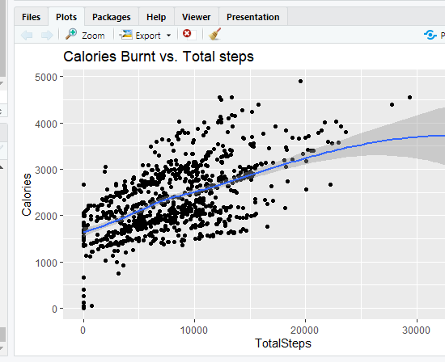



Phase 5: Share
There is a positive relationship between Calories burnt and the total steps.
The more steps a user does, more calories are burnt per day.
This shows users who walk regularly for longer distance burn lots of calories or do lots of physical activity.

Slide 9
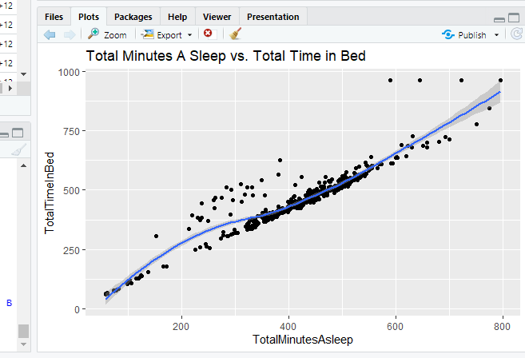
Share Cont…
There is a positive relationship between total Minutes a sleep vs. Total Time in Bed.
For the most part, the time participants spent asleep and the time they spent in bed was very similar.

Slide 10
Phase 6: Act
Recommendations:
After analyzing the data, there is a lot of missing data.
With further research and data manipulation, we may be able to determine further and more accurate findings for this fitness company.
Instead of surveying only 30 fit bit users, we need about 50 users to represent the population and we would need more women, elderly and children to help fill in the sections for activity level, sedentary minutes and total time in bed.
In addition, we would need a more current data set to forecast since health data from CDC and other health sites change with new and improved health and wellness recommendations.
The Fitbit tracker app should encourage fitness users to reach 10,000 steps a day and to encourage users to meet the goal.
The Fitbit app should also encourage fitness users to achieve either 150 to 300 minutes of moderate-intensity aerobic activity per week or 75 to 150 minutes of vigorous-intensity aerobic activity per week, plus two days of strength training to meet the world health organizations guidelines.
For the sedentary users, if they want to get active, then the fit bit app may encourage by providing enable alert notifications to reach active minute levels and recommend exercise trainings.
After reaching daily activity levels, the Fitbit app must recommend users to get at least 7 hours of sleep per night and enable alert notifications to encourage users to meet this.

Slide 11
References:
https://www.livestrong.com/article/309663-how-many-calories-does-a-sedentary-person-burn-each-day/
https://www.realsimple.com/health/fitness-exercise/sedentary-lifestyle-signs
https://www.cancer.org/healthy/cancer-causes/diet-physical-activity/body-weight-and-cancer-risk/adult-bmi.html

Slide 12
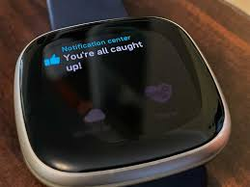
Thank You for Your Attention!

